Slide 1
How to call de Verdiersalen using Zoom
and make de Verdiersalen the meeting host

Slide 3
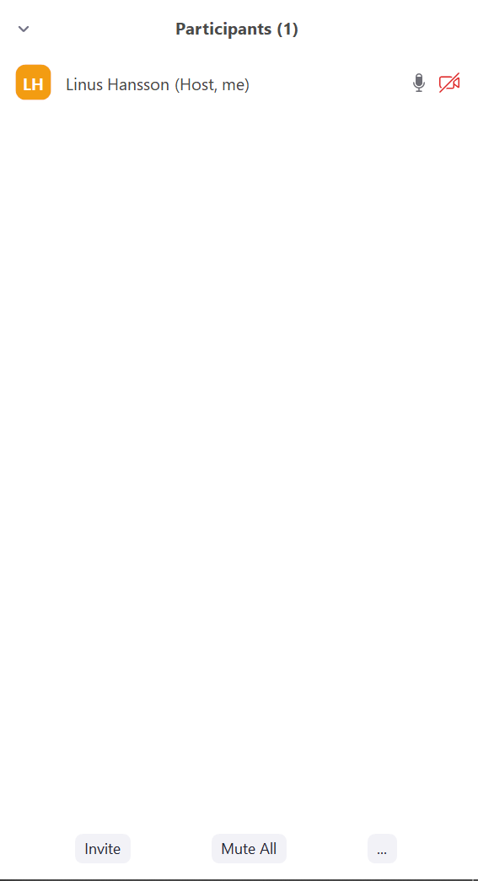
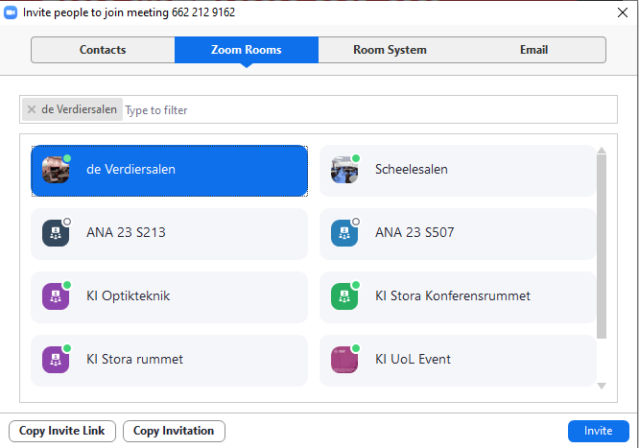

Slide 4
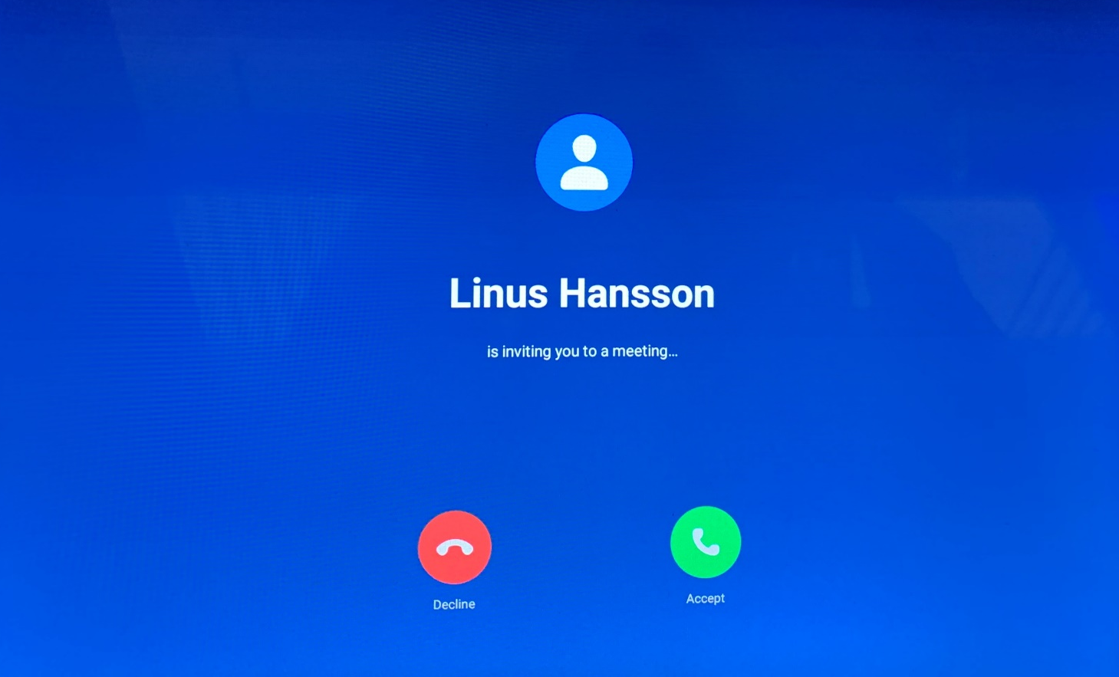

Slide 5
