Slide 1
LABMED Mingle 2023-06-15

Slide 2
Project
The department is redeploying localities within ANA Futura.
New groups are moving into ANA Futura, 60-70 new people.
More synergies between researchers, groups and teaching opportunities.
Effective use of space to reduce costs.
Creating a vivid, interactive and vibrant research environment.
Time frame: Move should be done by the end of 2023 and adjustments after that.

Slide 3
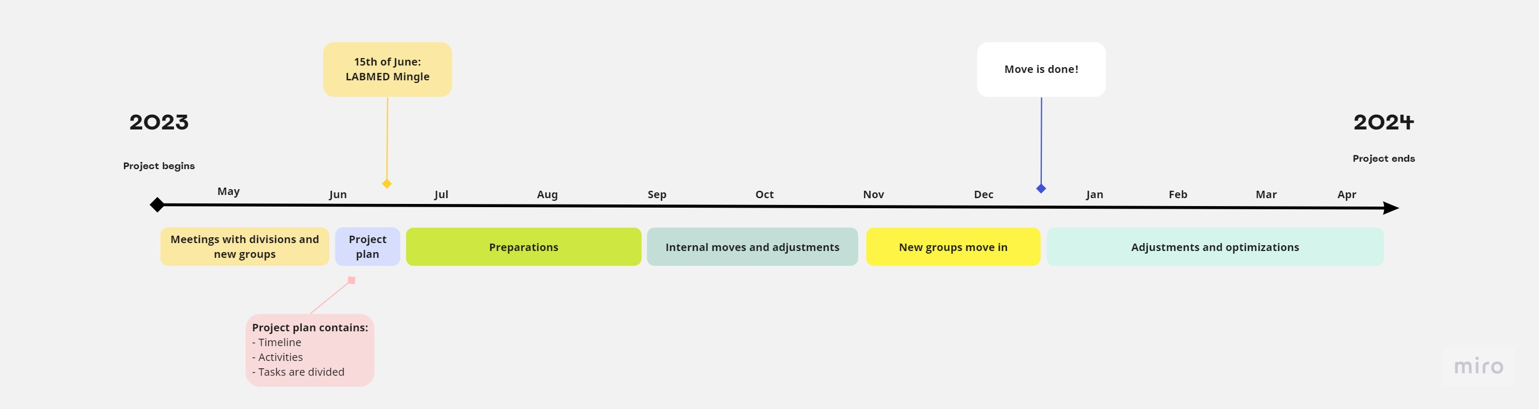
Timeline

Slide 4
What has happened so far?
Meetings with the groups moving in.
Meetings with divisions and PI:s already in ANA Futura.
Meetings with service team and biosafety officer.
Information gathering.
Measurements and tracking of the usage of the premises (ongoing).
Website with information about the project is now on KI´s webpage.
Preliminary plan for lab localizations is in the works.

Slide 5
floor 7

Slide 6
floor 8

Slide 7
Next steps:
Labmed Mingle and workshops – the input is used in planning the change!
Making a more detailed plan.
  ANA Futura visits for groups moving in.
  Incorporate feedback and make a more detailed plan.
ANA Futura access cards for everyone.
Risk assessments and union collaboration (facklig samverkan).

Slide 8
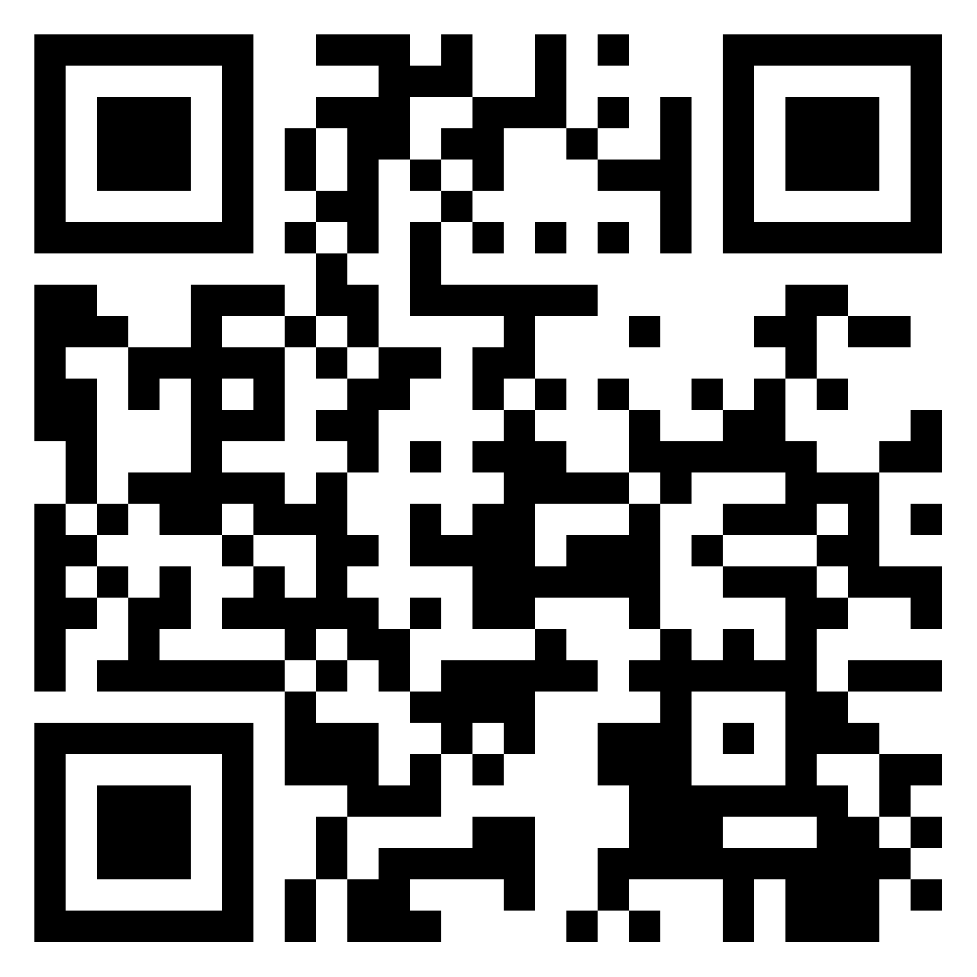
Workshop instructions
Divide yourself into groups of 4-6 people from mixed groups/divisions
Open the padlet (QR-code on the right)
Discuss the questions, put your answers into padlet.
Present your ideas shortly
https://padlet.com/robertmansson2/ana-futura-workshop-ppn8ugtp532uprkw

Slide 9
Workshop questions
What oppertunities do you see with the relocalisation?
What challenges do you see with the relocalisation?
How do we improve cooperation, networking and synergy within labmed?
What principles should we have for shared facilities/labs/offices?
How do we share facilities that require special permits? (virus labs etc)
Other questions? Requests? Suggestions?

Slide 10
Avslutningsbild med Karolinska Institutets logotyp

